Slide 1

MAXIMIZING REVENUE FOR DRIVERS
STATISTICAL ANALYSIS

Slide 2
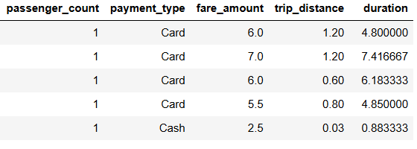
Data Overview
For this analysis, we utilize the comprehensive dataset of NYC Taxi Trip records, used data cleaning and feature engineering procedures to concentrate solely on the relevant columns essential for our investigation.
Relevant columns used for this research:
l. passenger_count (1 to 5)
ll. payment_type (card or cash)
lll. fare_amount
lV. Trip_distance (miles)
V. duration (minutes)

Slide 3
Methodology
Step | Description
Descriptive Analysis
Performed statistical analysis to summarize key aspects of the data, focusing on fare amounts and payment types.
Hypothesis Analysis
Conducted a T-test to evaluate the relationship between payment type and fare amount, testing the hypothesis that different payment methods influence fare amounts.

Slide 4
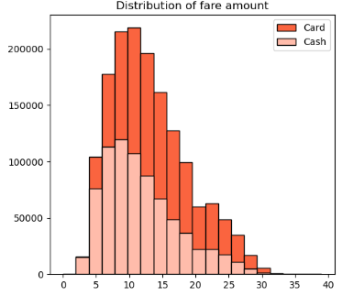
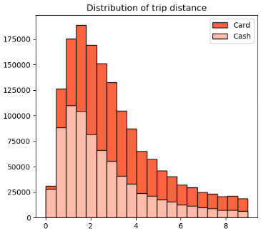
Journey Insights
Customers paying with cards tend to have a slightly higher average trip distance and fare amount compared to those paying cash.
Indicates that customers prefer to pay more with cards when they have high fare amount and long trip distance.

Slide 5
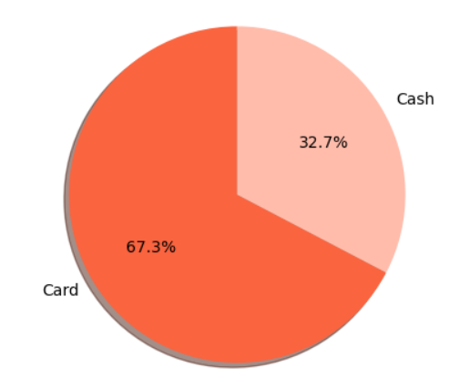
Preference of Payment Types
The proportion of customers paying with cards is significantly higher than those paying with cash, with card payments accounting for 67.5% of all transactions compared to cash payments at 32.5%.
This indicates a strong preference among customers for using card over cash payments, potential due to convenience, security, or incentives offered for card transactions.

Slide 6
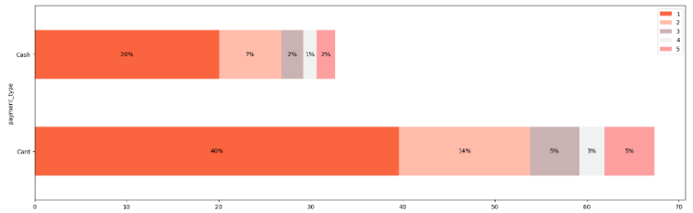
Passenger Count Analysis
Among card payments, rides with a single passenger (passenger count = 1) comprise the largest proportion, consulting 40.08% of all card transactions.
Similarly, cash payments are predominantly associated with single-passenger rides, making up 20.04% off all cash transactions.
This is noticeable decrease in the percentage of transactions as the passenger count increases, suggesting that larger groups are less likely to use taxis or may opt for alternative payment methods.
These insights emphasize the importance of considering both payment method and passenger count when analyzing transaction data, as they provide valuable insights into customer behavior and preferences.

Slide 7
Hypothesis Testing
Null hypothesis: There is no difference in average fare between customers who use credit cards and customers who use cash.
Alternative hypothesis: There is a difference in average fare between customers who use credit cards and customers who use cash.
With a T-statistics of 169.2, we reject the null hypothesis, suggesting that there is indeed a significant difference in average fare between the two payment methods.

Slide 8
Recommendations
Encourage customers to pay with credit cards to capitalize on the potential for generating more revenue for taxi cab drivers.
Implement strategies such as offering incentives or discounts for credit card transactions to incentivize customers to choose this payment method.
Provide seamless and secure credit card payment options to enhance customer convenience and encourage adoption of this preferred payment method.

